Slide 1

Tribhuvan University
Butwal Multiple Campus
Introduction to Information Technology
TOPIC :-
Database Management System
@ Ayush Khatri
PRESENTING BY :
@ Ritesh Pokhrel
@ Bishal Bhattrai
@ Binod Kandel

Slide 2
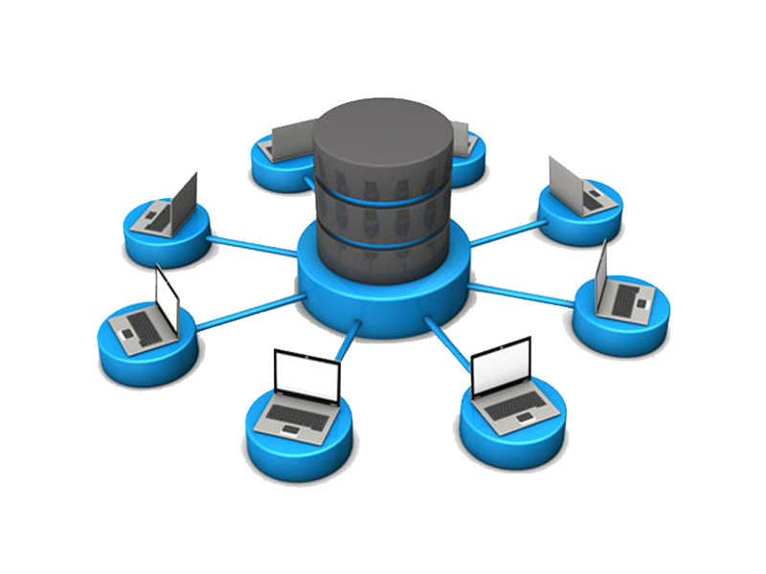
Introduction
DBMS stands for Database Management System.
DBMS is form by Database and Management System where as database means Collection of related data stored electronically in systematic Manner and management system means set of program to store and retrieve those data(present in database).
DBMS is a collection of data and set of program to access and store those data in an easy and efficient manner. DBMS is a software which is used to manage database.
DBMS allow the to modify the database.
Source:- www.targetech.com

Slide 3

CHARACTERISTICS
1) Real World Entity
The DBMS is designed in such a way that it can cater to the needs of huge business organizations and can store large data with efficient operations on them. Database can store things like cost of vegetables or cost of different brands of breads etc.
2) Stores Any Kind of Structured Data
DBMS can store practically any data that exists in the world and is structured and this is yet another very important characteristic because we need to work on every kind of data present.
3) Security
The access to make changes to a database by the user is limited and the users not able to access entire database.
4) Ease of access
we can run a search query to find any data and the process is way faster then manual searching and is more reliable
Source:- www.interviewbit.com

Slide 4

ELEMENT
1) Storage engine
The storage engine is the core component of the DBMS that interacts with the file system at an OS level to store data. All SQL queries which interact with the underlying data go through the storage engine.
2) Log manager
This component will keep all the logs of the DBMS. These logs will consist of user logins and activity, database functions, backups and restore functions, etc. The log manager ensures all these logs are properly recorded and easily accessible.
3) Reporting & monitoring tool
Reporting and monitoring tools are another standard component that comes with a DBMS. Reporting tools will enable users to generate reports while monitoring tools enable monitoring the databases for resource consumption, user activity, etc.
4) Query processor
This is the intermediary between the user queries and the database. The query processor interprets the queries of users and makes them actionable commands that can be understood by the database to perform the appropriate functionality.
SOURCE:- www.bmcsoftware.com

Slide 5
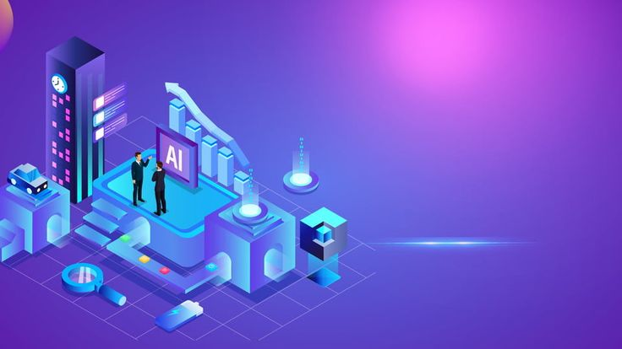
APPLICATION
1) Railway Reservation System
In the rail route reservation framework, the information base is needed to store the record or information of ticket appointments, status about train’s appearance, and flight. Additionally, if trains get late, individuals become acquainted with it through the information base update.
2) Library Management System
There are lots of books in the library so; it is difficult to store the record of the relative multitude of books in a register or duplicate. Along these lines, the data set administration framework (DBMS) is utilized to keep up all the data identified with the name of the book, issue date, accessibility of the book, and its writer.
3) Online Shopping
These days, web-based shopping has become a major pattern. Nobody needs to visit the shop and burn through their time. Everybody needs to shop through web based shopping sites, (for example, Amazon, Flipkart, Snap deal) from home.
4) Education Sector
Presently, assessments are led online by numerous schools and colleges. They deal with all assessment information through the data set administration framework (DBMS). In spite of that understudy’s enlistments subtleties, grades, courses, expense, participation, results, and so forth all the data is put away in the information base.
SOURCE:- www.geeksforgeeks.com

Slide 6
THANK YOU

